Slide 1
LEVERAGE ANALYSIS
CONCEPTUAL FRAMEWORK
BY:
Dr. Manish Sitlani

Slide 2
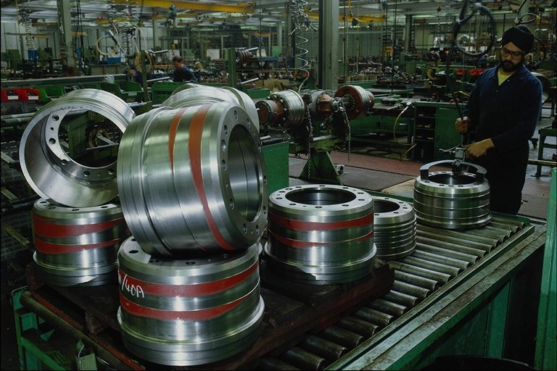
% CHANGE IN DEPENDENT VARIABLE
DoL= ----------------------------------------------------------
% CHANGE IN INDEPENDENT VARIABLE

Slide 3
TYPES OF LEVERAGES
OPERATING LEVERAGE
FINANCIAL LEVERAGE
COMBINED LEVERAGE

Slide 4
Income Statement of a Firm
Sales
- Variable cost
Contribution
- Fixed Cost
EBIT / OPERATING INCOME
- Interest
EBT
- Tax
EAT
- Preference Dividend
Earning After Tax & Pref. Dividend
E.P.S = Earning After Tax & Pref.Dividend
Number of Outstanding Equity Shares

Slide 5
INCOME STATEMENT
Sales
- Variable cost
Contribution
- Fixed Cost
EBIT / OI
DOL= %Change in EBIT
%Change in Sales
OR Contribution
EBIT

Slide 6
INCOME STATEMENT
EBIT / OI
- Interest
EBT
- Tax
EAT
- Preference Dividend
Earning After Tax & Pref. Dividend
DFL= %Change in EPS
%Change in EBIT
OR EBIT
EBT

Slide 7
COMBINED LEVERAGE
DCL= DOL X DFL
OR
% CHANGE IN EPS
% CHANGE IN SALES
OR
CONTRIBUTION
EBT

Slide 8
RELATIONSHIP OF LEVERAGE WITH
COST OF CAPITAL

Slide 9
IMPORTANCE & SIGNIFICANCE OF
OPERATING LEVERAGE
FINANCIAL LEVERAGE

Slide 10

OPERATING LEVERAGE
PARTICULARS | FIRM A | FIRM B
SALES | 1,00,000 | 1,00,000
LESS: VARIABLE COST | 60,000 | 80,000
CONTRIBUTION | 40,000 | 20,000
LESS:FIXED COST | 20,000 | NIL
EBIT | 20000 | 20000
DOL | 2 | 1

Slide 11
OPERATING LEVERAGE
FIRM A
20% VARIATION IN SALES
PARTICULARS | 20% | BASIC | 20%
SALES | 1,20,000 | 1,00,000 | 80,000
- VARIABLE COST | 72,000 | 60,000 | 48,000
CONTRIBUTION | 48,000 | 40,000 | 32,000
- FIXED COST | 20,000 | 20,000 | 20,000
EBIT | 28,000 | 20000 | 12,000
% CHANGE IN EBIT | 40% |  | 40%

Slide 12
OPERATING LEVERAGE
FIRM B
20% VARIATION IN SALES
PARTICULARS | 20% | BASIC | 20%
SALES | 1,20,000 | 1,00,000 | 80,000
- VARIABLE COST | 96,000 | 80,000 | 64,000
CONTRIBUTION | 24,000 | 20,000 | 16,000
- FIXED COST | 0 | 0 | 0
EBIT | 24,000 | 20,000 | 16,000
% CHANGE IN EBIT | 20% |  | 20%

Slide 13
FINANCIAL LEVERAGE
PARTICULARS | FIRM A | FIRM B
EBIT | 20,000 | 20,000
LESS: INTEREST | 10,000 | NIL
EBT | 10,000 | 20,000
LESS: TAX @ 30% | 3,000 | 6,000
EAT | 7,000 | 14,000
EPS | 7000 = 7 1000 | 14000 = 7 2000
DFL | 2 | 1

Slide 14
FINANCIAL LEVERAGE
20% VARIATION IN EBIT
COMPANY A
PARTICULARS | 20% | BASIC | 20%
EBIT | 24,000 | 20,000 | 16,000
LESS: INTEREST | 10,000 | 10,000 | 10,000
EBT | 14,000 | 10,000 | 6,000
LESS: TAX @ 30% | 4,200 | 3,000 | 1,800
EAT | 9,800 | 7,000 | 4,200
EPS | 9.8 | 7 | 4.2
% CHANGE IN EPS | 40% | - | 40%

Slide 15
FINANCIAL LEVERAGE
20% VARIATION IN EBIT
COMPANY B
PARTICULARS | 20% | BASIC | 20%
EBIT | 24,000 | 20,000 | 16,000
LESS: INTEREST | NIL | NIL | NIL
EBT | 24,000 | 20,000 | 16,000
LESS: TAX @ 30% | 7,200 | 6,000 | 4,800
EAT | 16,800 | 14,000 | 13,200
EPS | 8.4 | 7 | 5.6
% CHANGE IN EPS | 20% | - | 20%

Slide 16

COMBINED EFFECT OF OPERATING AND FINANCIAL LEVERAGES
PARTICULARS | BASIC A | VARIATION | BASIC B | VARIATION
SALES | 1,00,000 | 1,20,000 | 1,00,000 | 1,20,000
LESS: VARIABLE COST | 60,000 | 72,000 | 80,000 | 96,000
CONTRIBUTION | 40,000 | 48,000 | 20,000 | 24,000
LESS:FIXED COST | 20,000 | 20,000 | NIL | NIL
EBIT | 20,000 | 28,000 | 20,000 | 24,000
LESS: INTEREST | 10,000 | 10,000 | NIL | NIL
EBT | 10,000 | 18,000 | 20,000 | 24,000
LESS: TAX @ 30% | 3,000 | 5,400 | 6,000 | 7,200
EAT | 7,000 | 12,600 | 14,000 | 16,800
EPS | 7 | 12.60 | 7 | 8.4

Slide 17
LEVERAGE ANALYSIS
OF
LARSEN AND TOUBRO LTD.

Slide 18
CAPITAL COMPONENTS OF
LARSEN & TOUBRO LTD. ( in crores of Rs.)
COMPONENTS | FY05 | FY04 | FY03 | FY02
DEBT | 1858.96 | 1324.31 | 3175.83
EQUITY SHARE CAPITAL | 25.98 | 24.88 | 248.67 | 248.66
TOTAL | 1884.94 | 1349.19 | 3424.50 | 3792.42
% of DEBT | 98.62% | 98.15% | 92.73% | 93.44 %
TOTAL OUSTANDING SHARES (NOS.) | 129924182 | 124401796 | 248668755 | 248660346

Slide 19
FINANCIAL LEVERAGE ANALYSIS
PARTICULARS | FY05 | FY04 | FY03 | FY02
EBIT | 1403.79 | 894.68 | 768.24 | 805.74
LESS: INTEREST | 117.35 | 125.90 | 261.28 | 406.89
EBT | 1286.44 | 760.78 | 506.96 | 390.85
LESS: TAX | 340.63 | 326.32 | 99.99 | (3.58)
EAT | 945.81 | 435.46 | 406.97 | 394.43
EPS | 72.80 | 35 | 16.36 | 15.86
% CHANGE IN EBIT (AS COMPARED TO P.y) | 57 | 16.5 | (4.65) | (3.12)
% CHANGE IN EPS | 108 | 114 | 3.15 | 26.88

Slide 20
THANK YOU
PRESENTED BY:
Dr. Manish Sitlani

